Slide 1
Advanced Excel

Slide 2
Trainer Guidelines for Conducting Class
Solve questions live by creating new blank files (Excel, Python, Jupyter notebook, Dashboard) during the session, rather than sharing completed solutions.
Review teaching materials and solutions beforehand, and prepare additional examples to reinforce learning.
Ensure online students can hear you and see the screen clearly at all times.
Test your computer and necessary software before class begins.
Check with online students every 15-20 minutes to see if they understand the material and have any questions.

Slide 3
Agenda
Pivots
Data Analysis In Excel - Trends, Patterns
Data Visualization In Excel - Column Charts, Line Charts, Pie Charts, Bar Charts, Area Charts, Scatter Plots
Working With Multiple Worksheets
Linking & Referencing The Data Between Worksheets

Slide 4
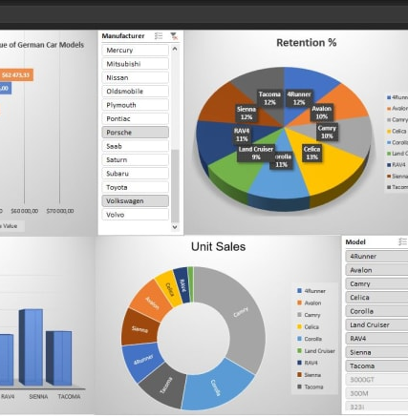
Pivots

Slide 5
Pivot Tables
Pivot tables are a powerful data analysis tool in Excel used to summarize, analyze, and visualize data from a larger dataset.
They allow you to reorganize and extract insights from your data quickly.
Creating a Pivot Table
Select Data: Highlight the dataset you want to use for the pivot table.
Insert Pivot Table: Go to the “Insert” tab and click on “PivotTable.”
Choose Data Range: Ensure Excel recognizes your data range. Adjust if necessary.
Design the Pivot Table: Drag and drop fields into the “Rows” and “Values” areas. For example, you can use a sales dataset to summarize sales by region.
Customize: You can customize your pivot table with various options, such as filters, sorting, and calculations

Slide 6
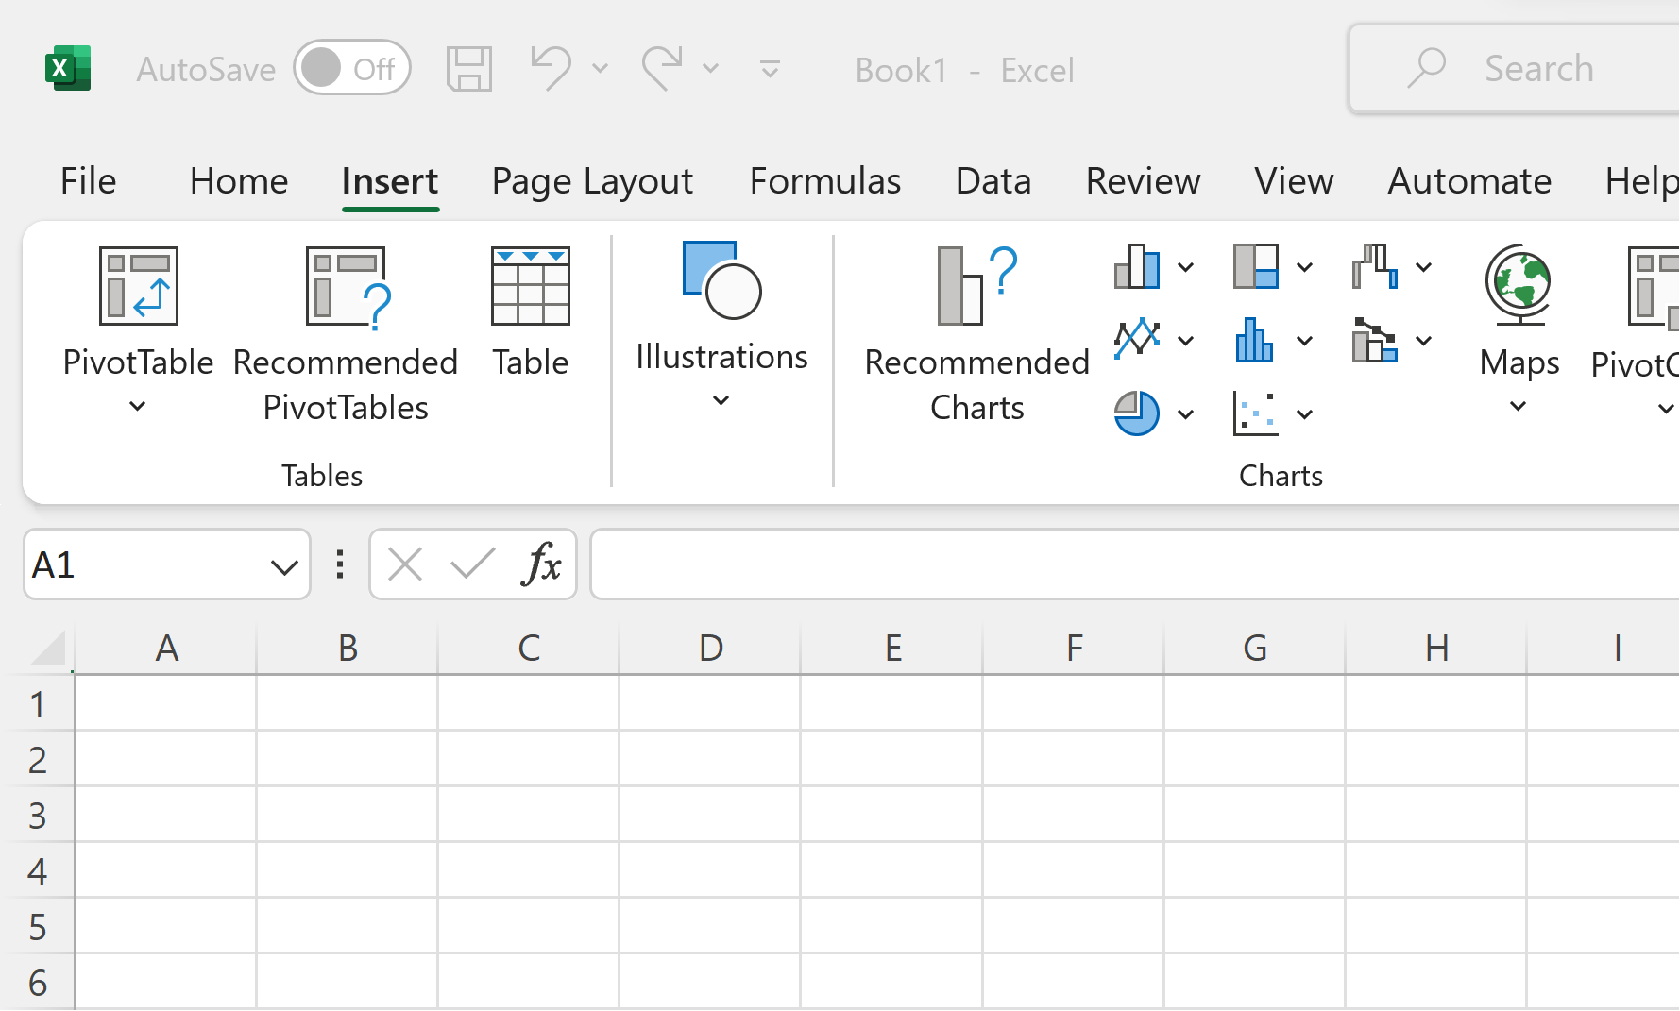
Cont…

Slide 7

Cont…
Modifying Pivot Tables
You can modify a pivot table by adding or removing fields, changing the layout, or applying different calculations.
Filtering and Sorting Data
Pivot tables offer easy filtering and sorting options to focus on specific data points.

Slide 8
Cont…
Modifying Pivot Tables
You can modify a pivot table by adding or removing fields, changing the layout, or applying different calculations.
1
Filtering and Sorting Data
Pivot tables offer easy filtering and sorting options to focus on specific data points
2
Conditional Formatting for Insights
Use conditional formatting to visually highlight data points and detect patterns in your dataset.
3

Slide 9
Cont…
Superstore Dataset: Practical Exercise
Content: A fictional sales dataset often used for data analysis and learning.
Data Categories: Covers orders, products, customers, sales, and profits.
Temporal Scope: Spans multiple years for time-based analysis.
Geographical Scope: Diverse, allowing regional or geographical comparisons.
Data Size: Typically includes thousands of rows for comprehensive analysis

Slide 10
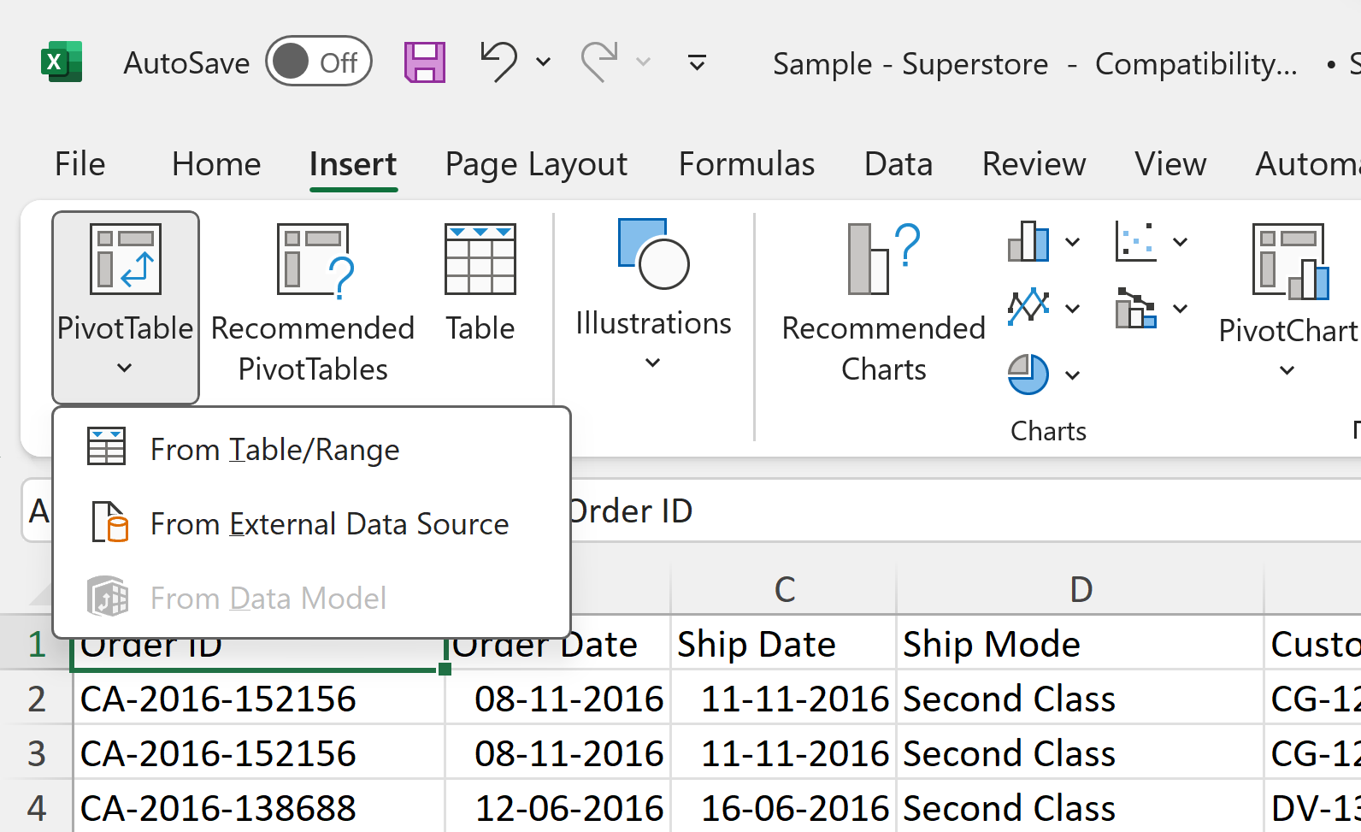
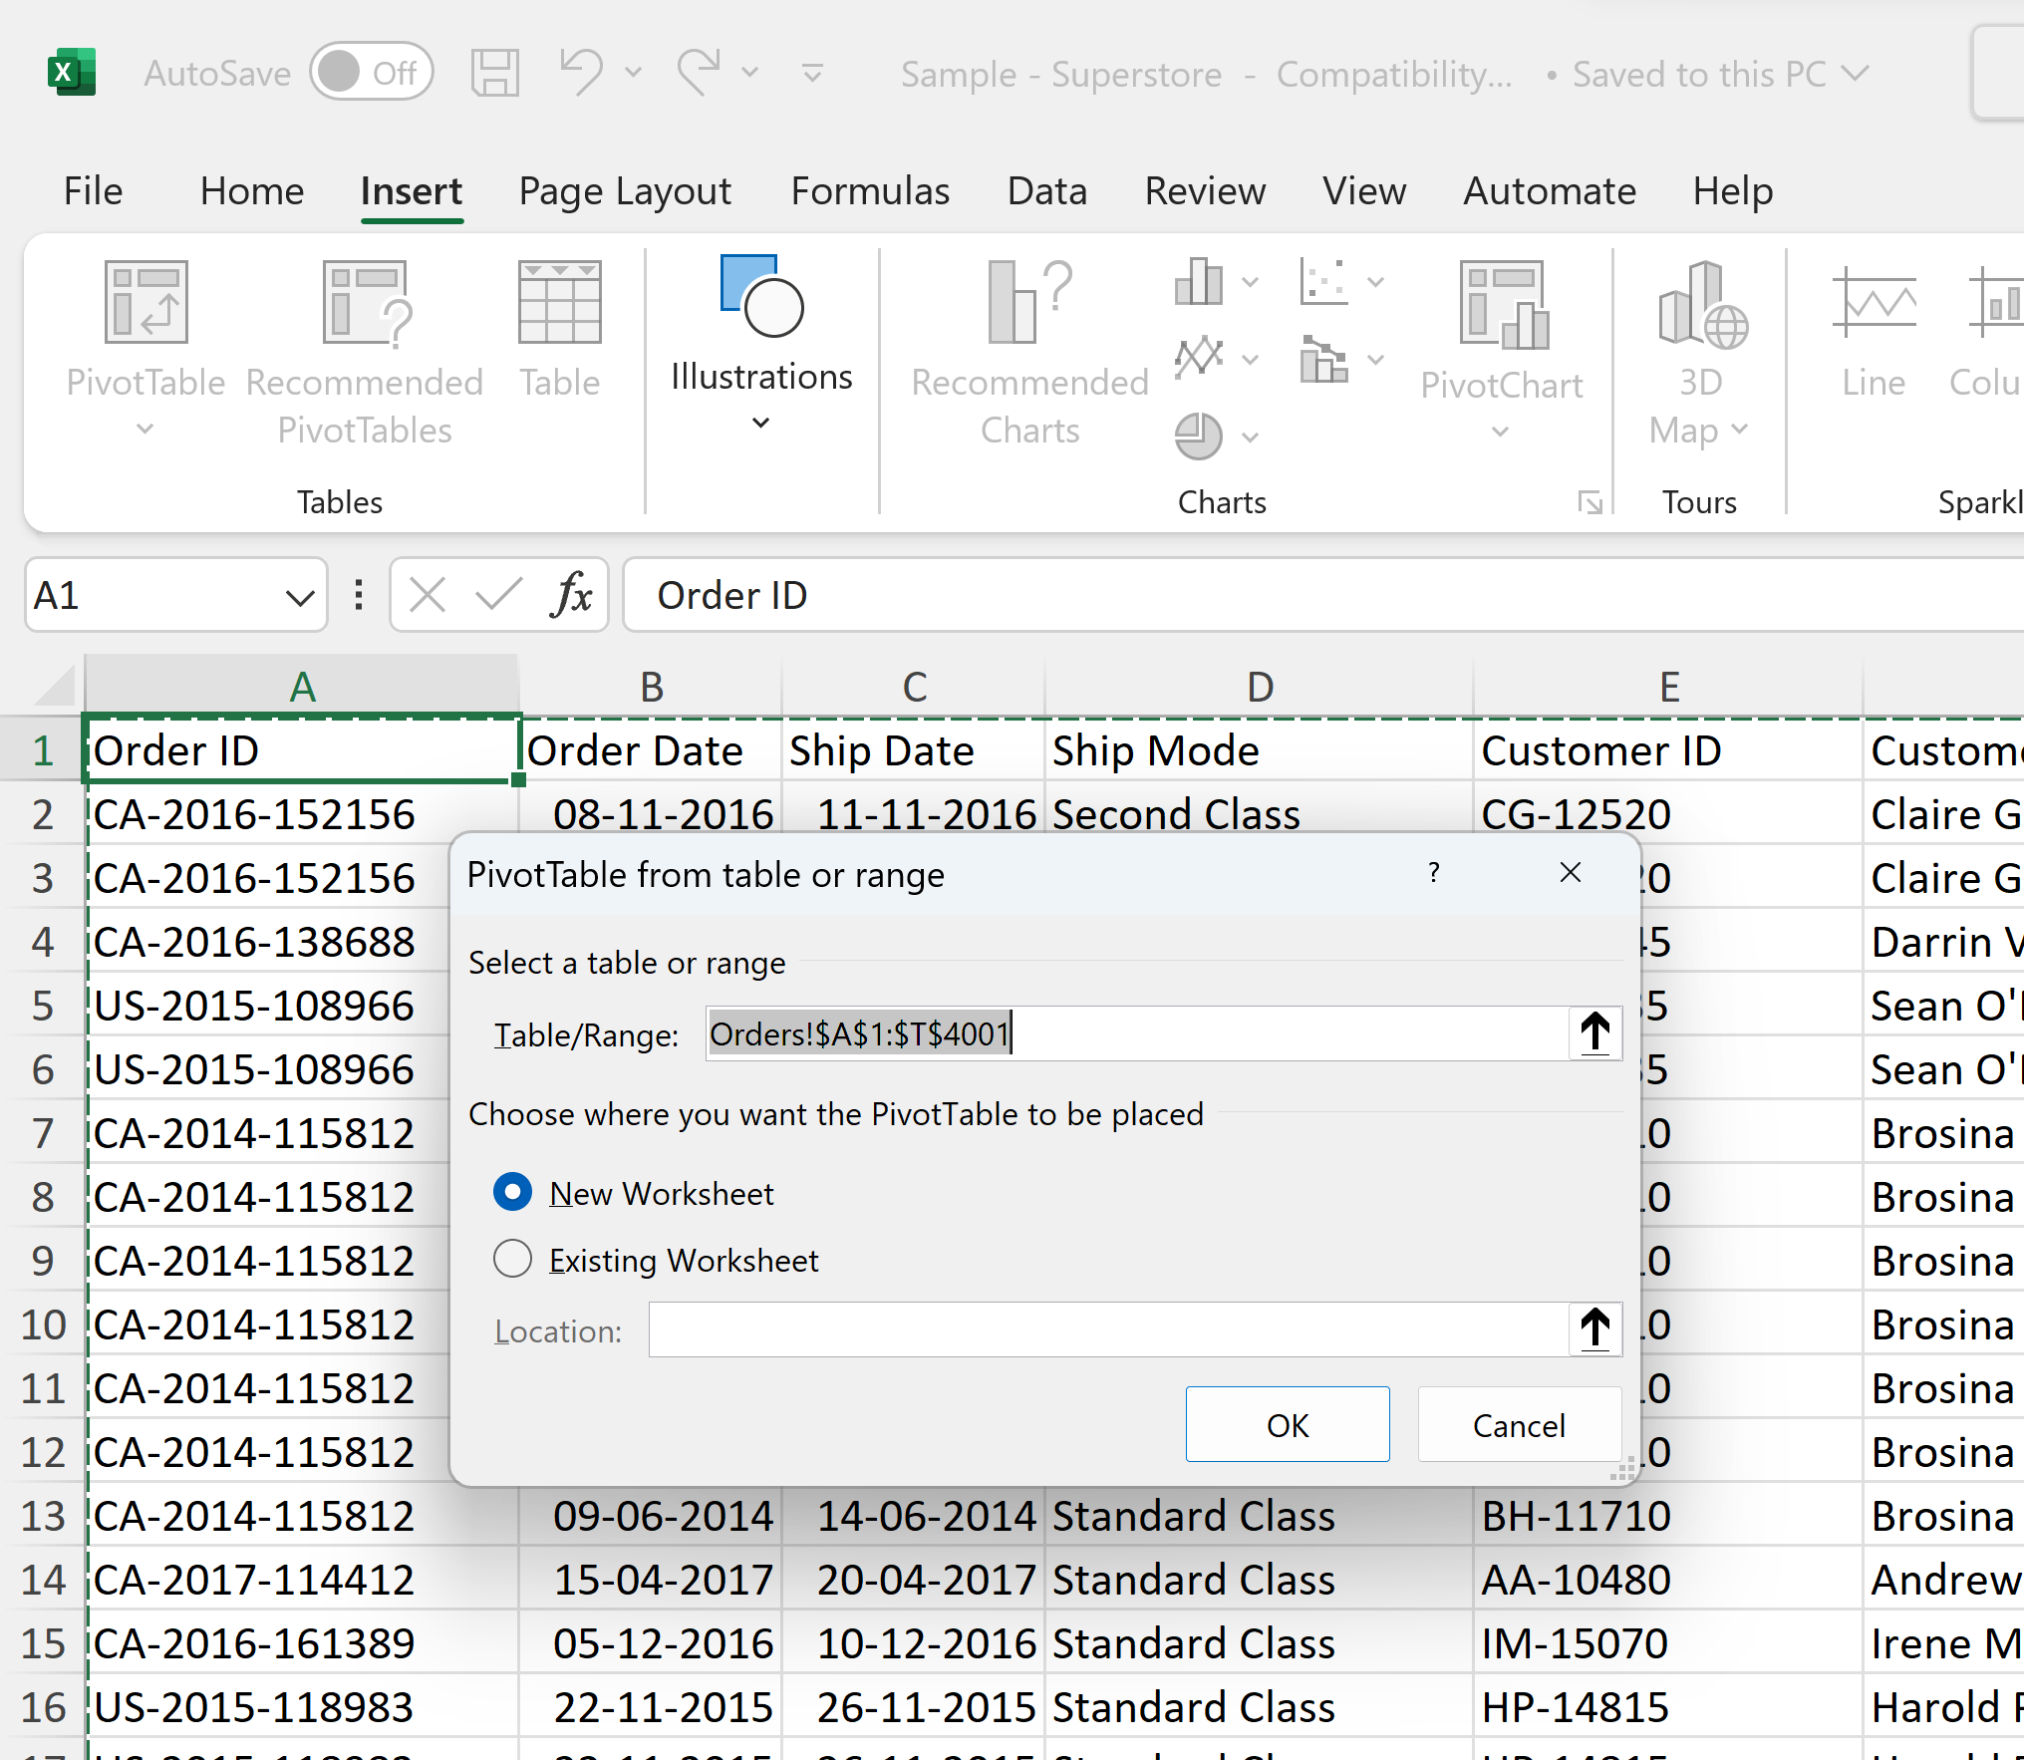
Cont…

Slide 11
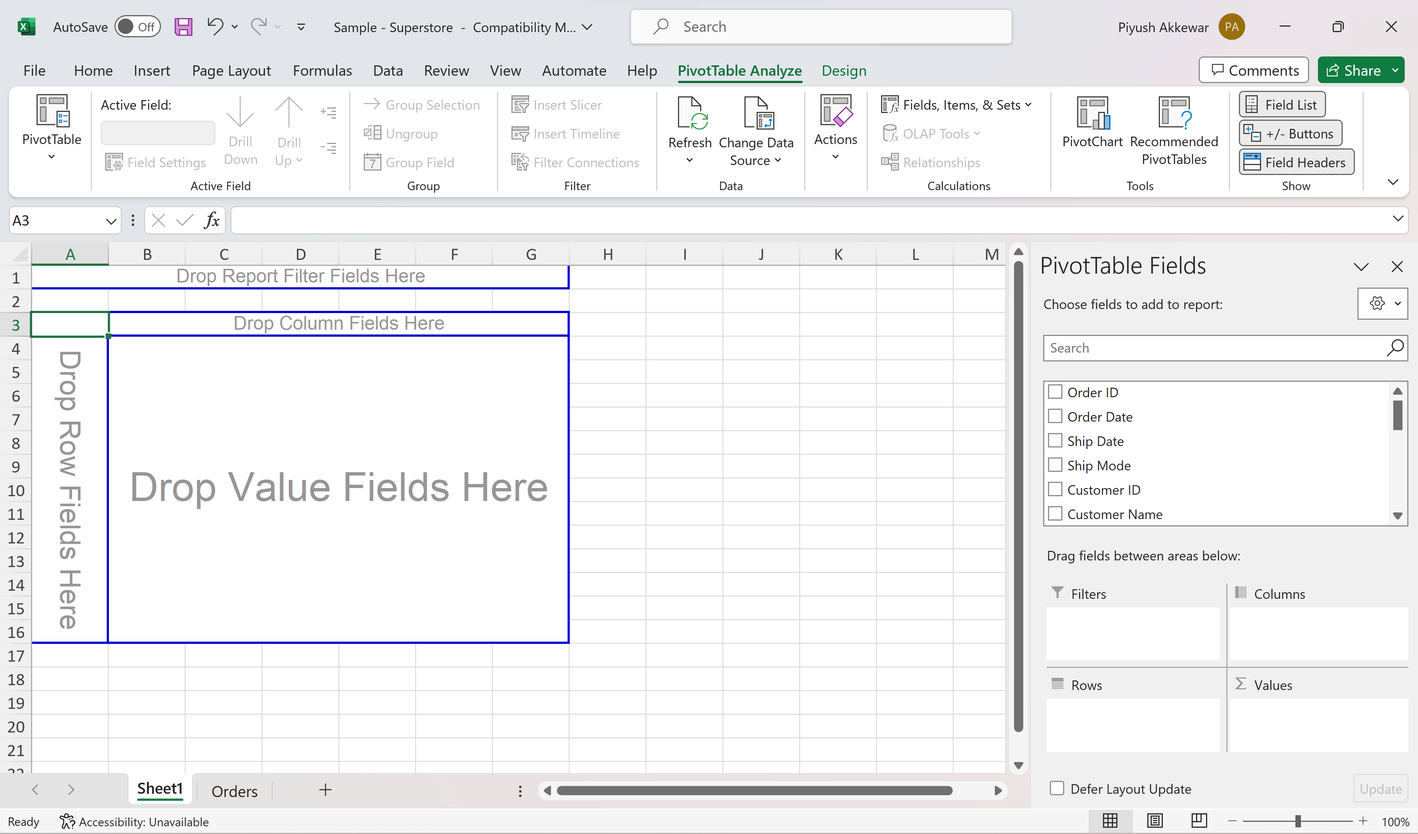
Cont…

Slide 12
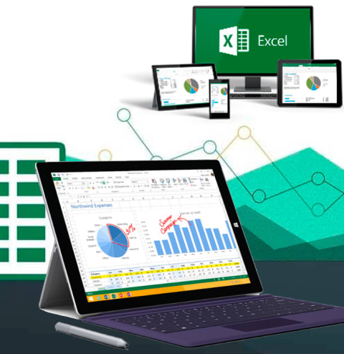
Data Analysis In Excel - Trends, Patterns

Slide 13
Data Analysis in Excel
Identifying Trends and Patterns
Data analysis in Excel involves recognizing trends and patterns in your dataset.
These trends can be related to time, seasonality, or other factors
1
Using IF and VLOOKUP Functions
IF Function: Apply conditional logic to analyze data based on specific criteria.
VLOOKUP Function: Retrieve data by matching a lookup value to a table
2
Conditional Formatting for Insights
Use conditional formatting to visually highlight data points and detect patterns in your dataset.
3

Slide 14
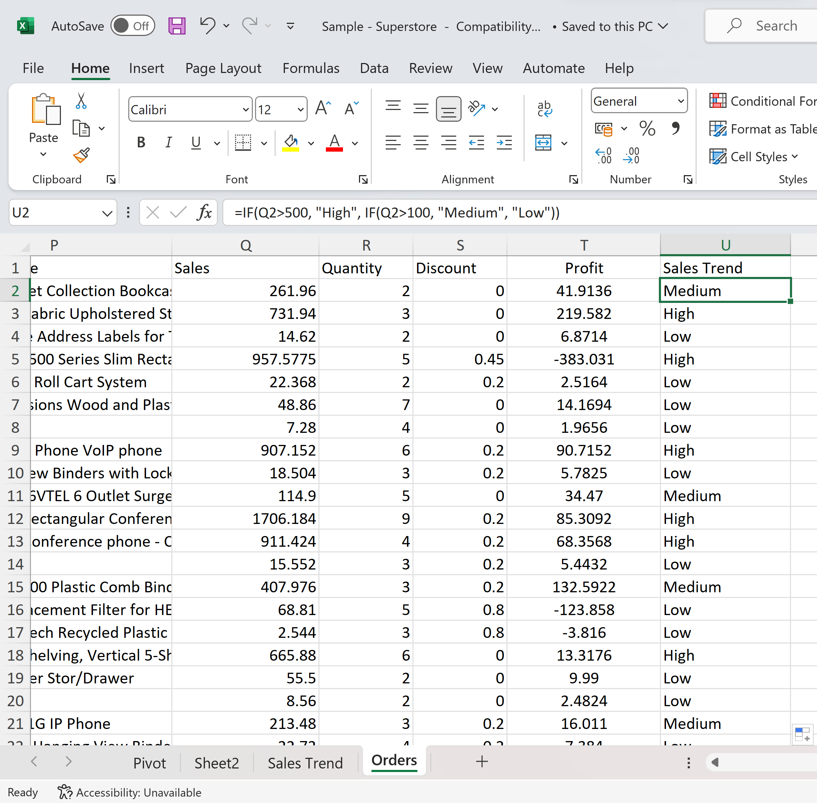
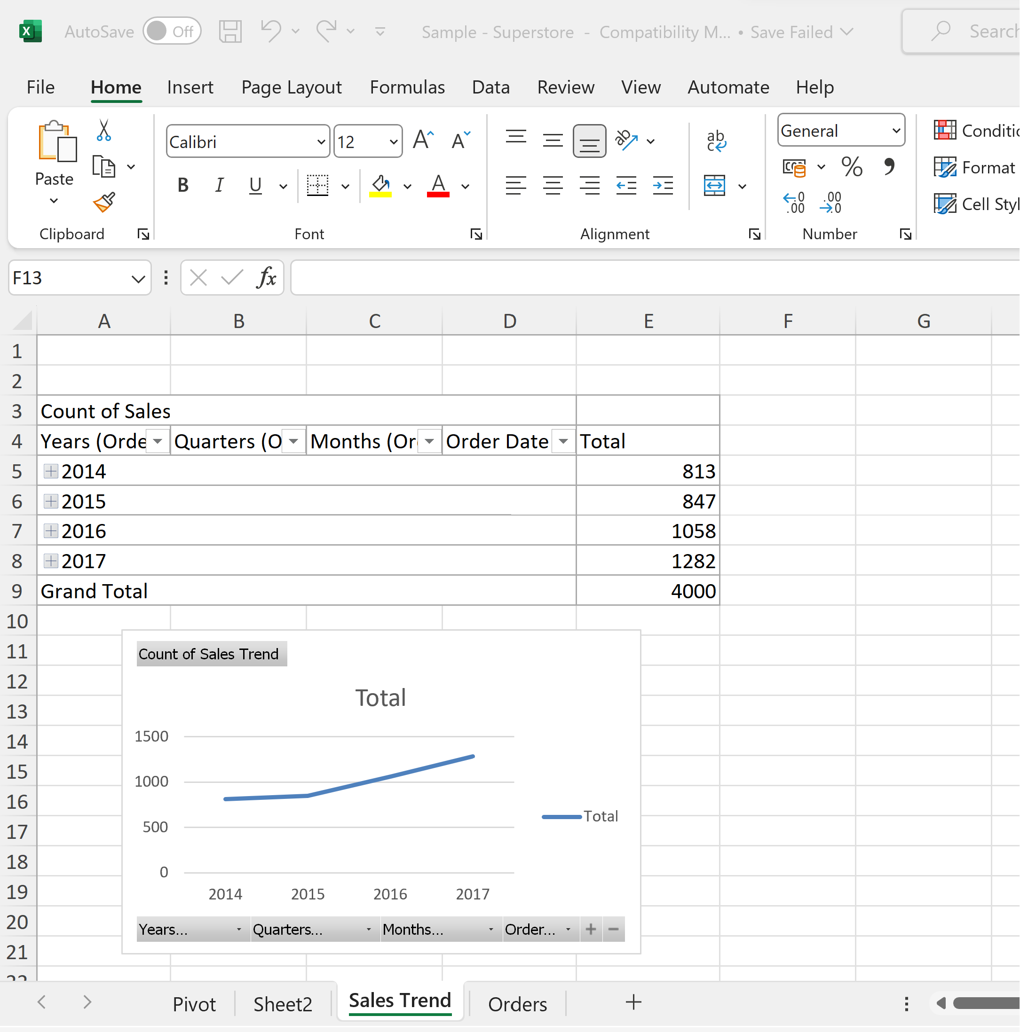
Cont…
If you want to categorize sales into different groups (e.g., "High," "Medium," "Low" sales), you can create a new column and use the IF function.
=IF(Sales > 500, "High", IF(Q2 > 100, "Medium", "Low"))
Once done, a line graph with time can be made to show the sales trends.

Slide 15
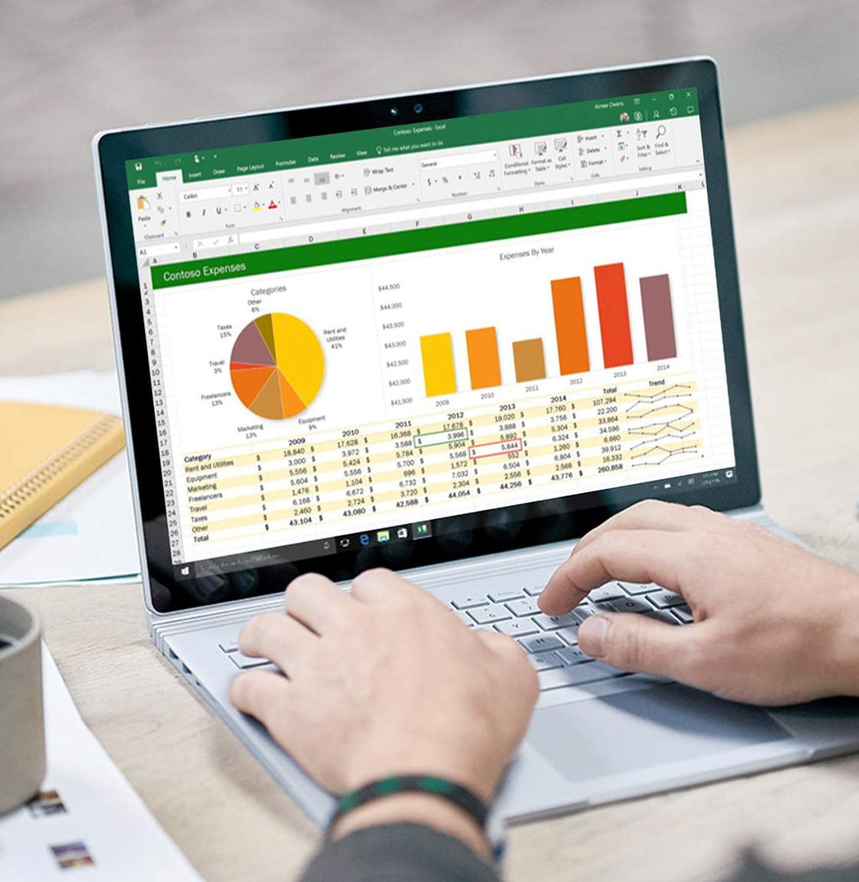
Data Visualization In Excel - Column Charts, Line Charts, Pie Charts, Bar Charts, Area Charts, Scatter Plots

Slide 16
Data Visualization in Excel
Excel offers various chart types (e.g., column, line, pie) for visualizing data.
Create charts by selecting data, navigating to the "Insert" tab, and choosing a chart type.
Customize charts with formatting, colors, titles, and fonts.
Add data labels and legends for clarity.
Visualizations reveal trends, patterns, and anomalies in data.
Interactive features, pivot tables, and conditional formatting enhance data analysis.
Excel's charts help transform raw data into meaningful insights for informed decision-making.

Slide 17
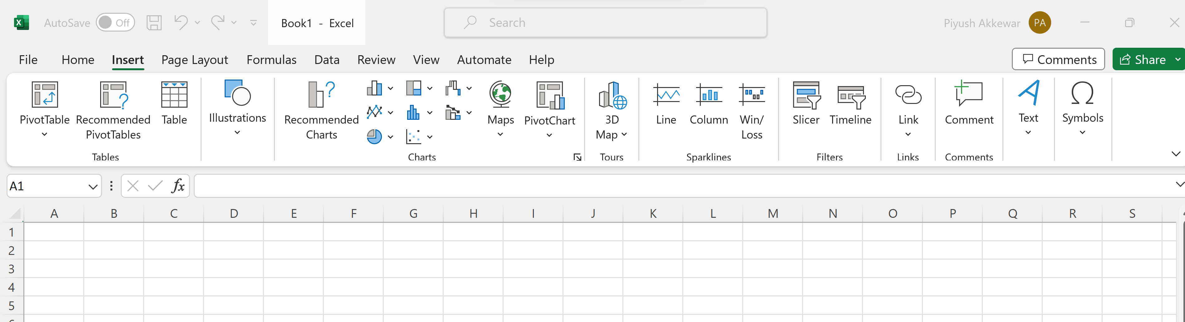
Cont…

Slide 18
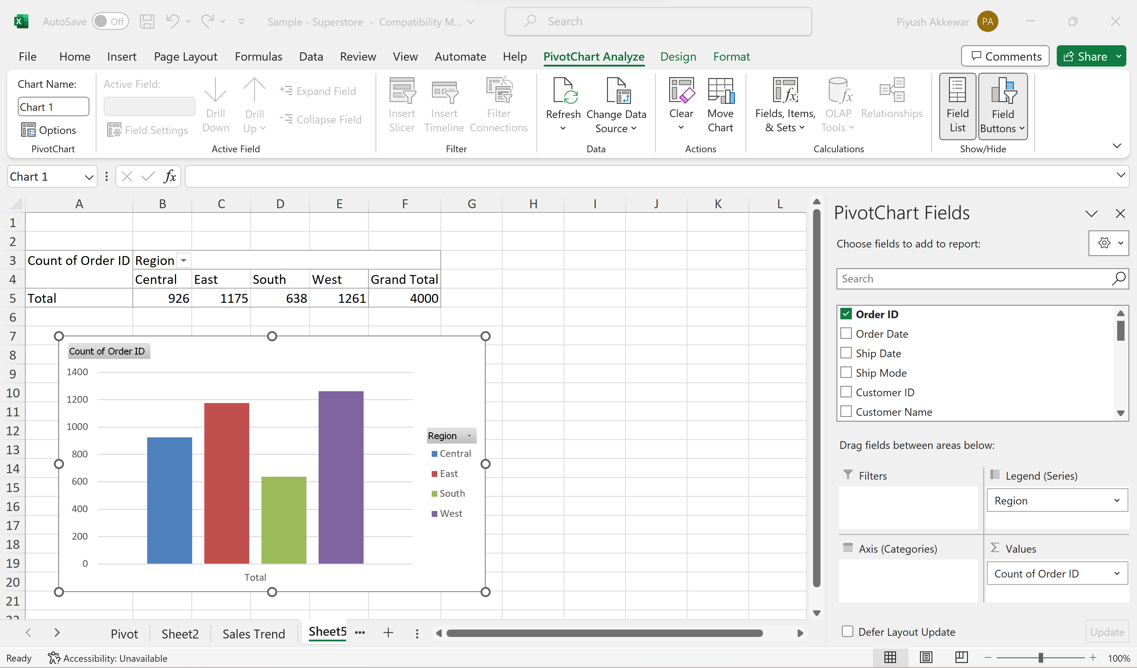
Cont…
Column Charts
Select your data and go to the "Insert" tab in Excel.
Choose "Column Chart" and select the appropriate subtype (e.g., clustered or stacked).

Slide 19
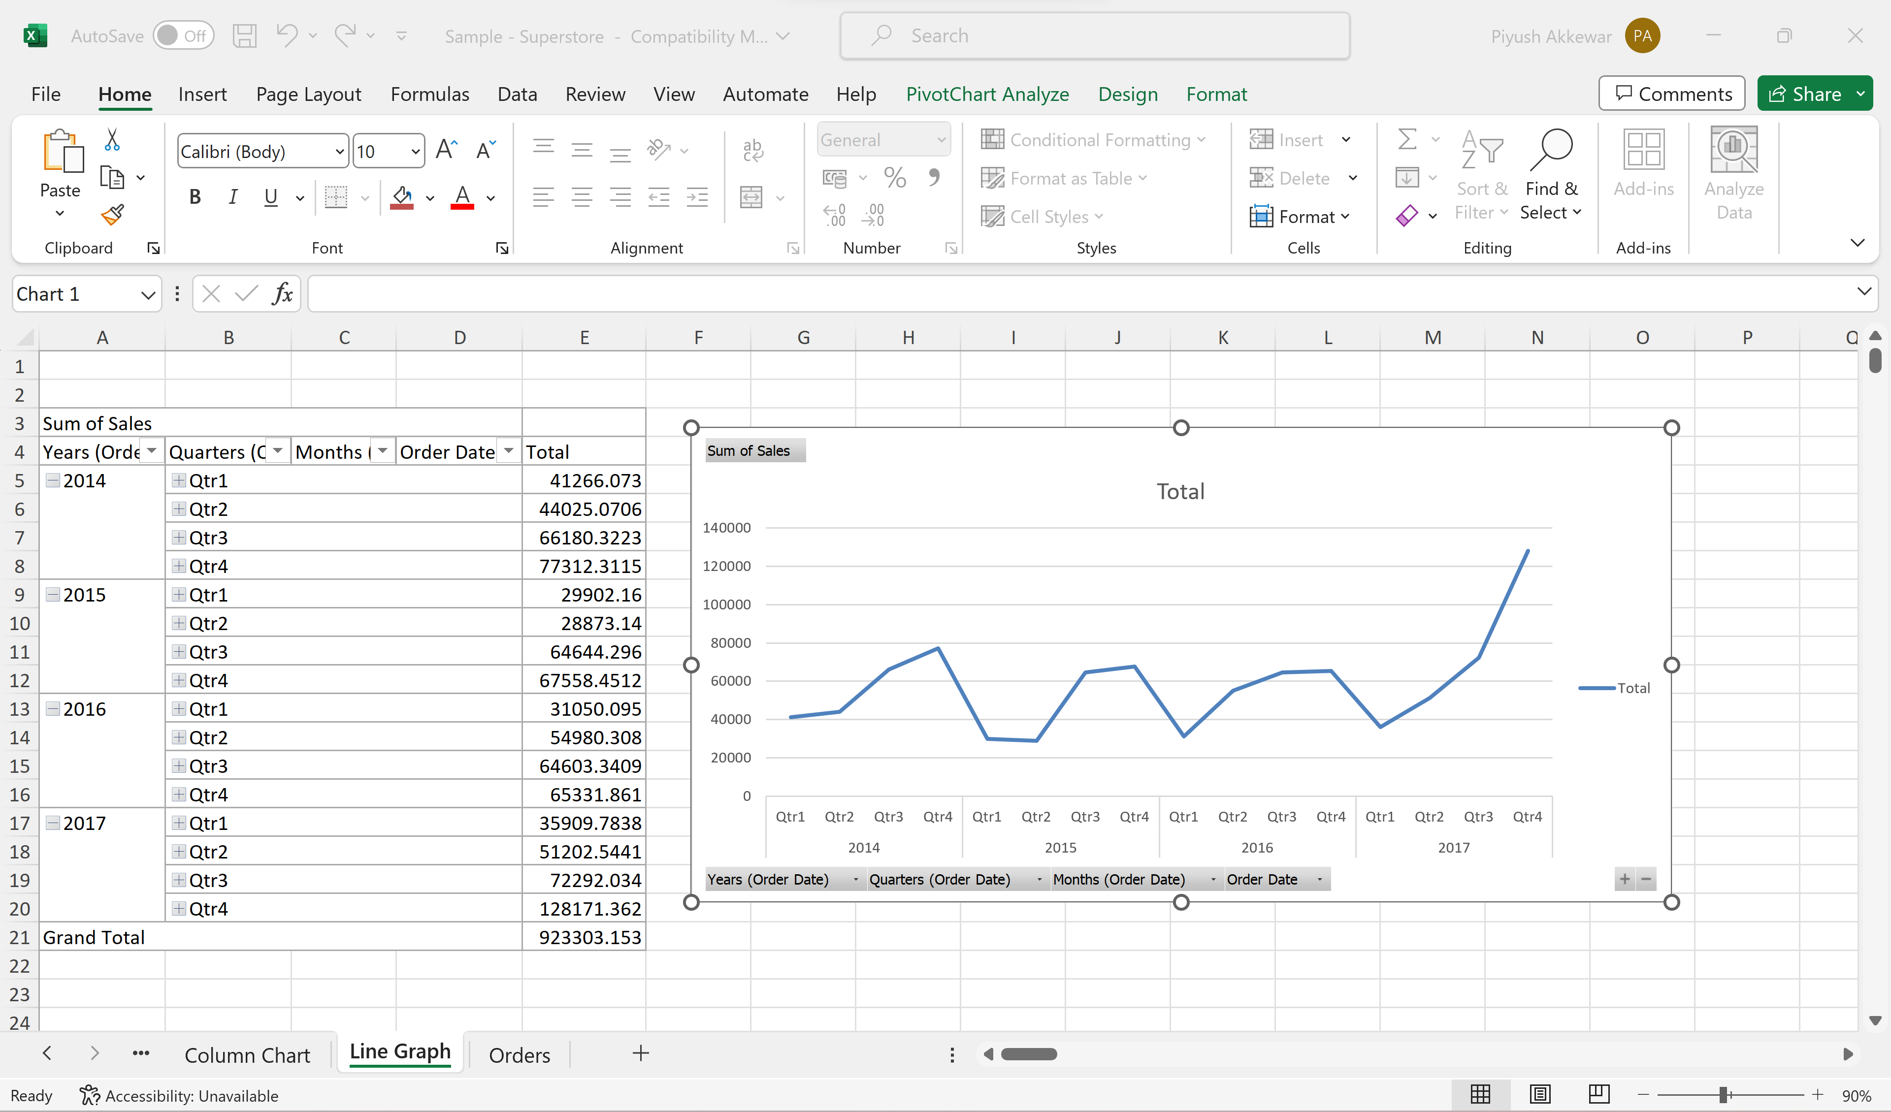
Cont…
Line Charts
Line charts are ideal for visualizing trends over continuous data.
Create one by selecting your data and choosing "Line Chart" from the "Insert" tab in Excel.

Slide 20
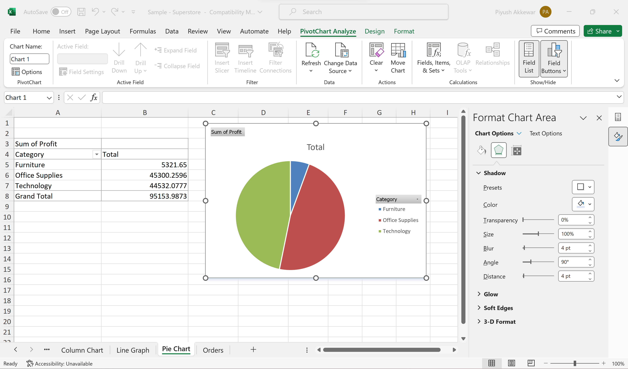
Cont…
Pie Charts
In Excel, select data and insert a pie chart.
Customize colors, labels, and explosion for clarity.

Slide 21
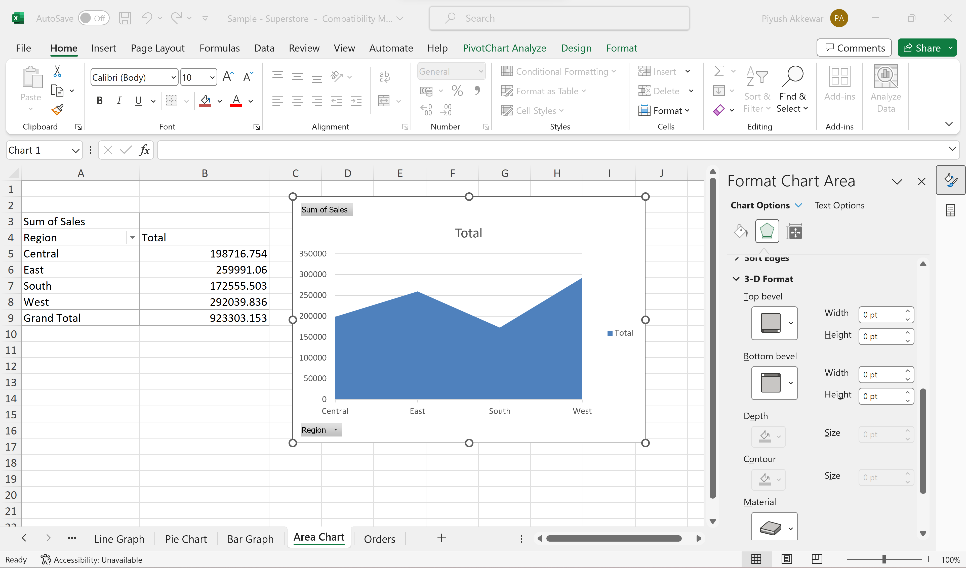
Cont…
Area Charts
In Excel, select data and insert an area chart.
Depict data with filled areas below lines.
Useful for showing trends over time.

Slide 22
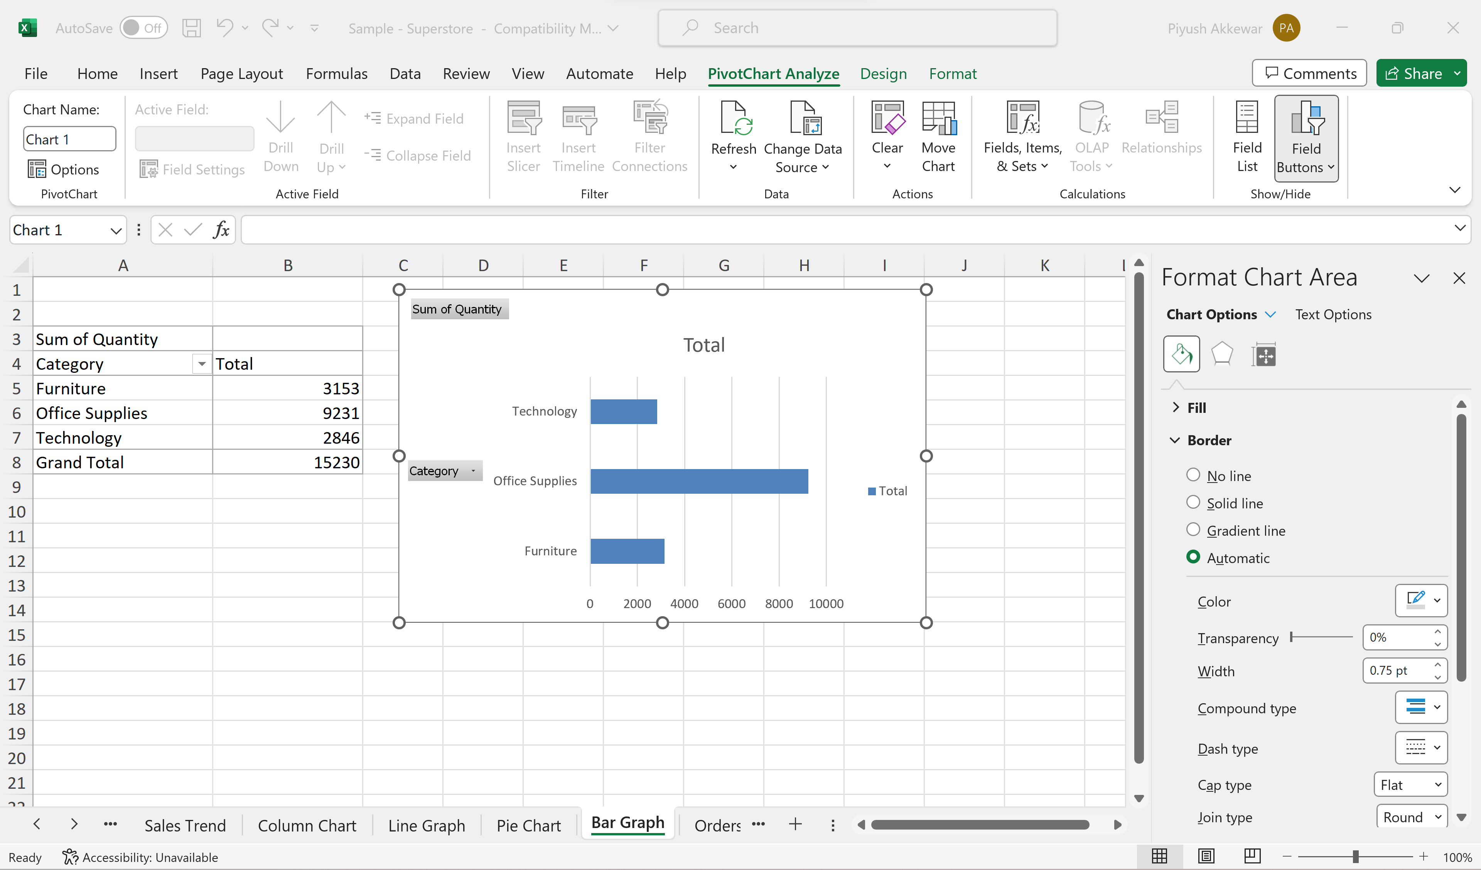
Cont…
Bar Charts
In Excel, select data and insert a bar chart.
Choose from different styles and layouts.

Slide 23
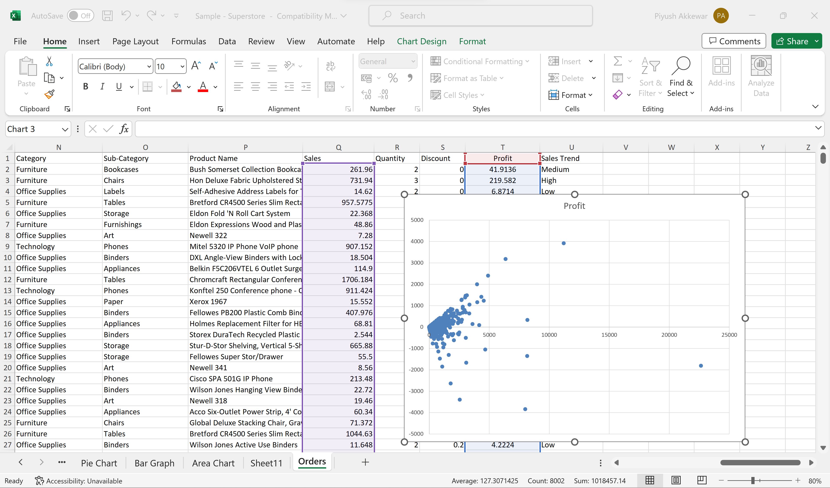
Cont…
Scatter Charts
Ideal for exploring relationships between two variables
Scatter plots reveal patterns and correlations.
Easily identify outliers and clusters.
Select Columns; 'Sales' & "Profit', then insert scatter formula

Slide 24

Working With Multiple Worksheets

Slide 25
Multiple Sheets in Excel
Create New Sheets: Add new sheets for data organization. Click the "+" icon next to the sheet tabs at the bottom, or right-click an existing sheet tab and select "Insert" to add a new sheet.
1
Rename Sheets: Give sheets meaningful names for clarity. Right-click on a sheet tab
2
Move or Copy Data: Easily transfer data between sheets.
3
Use Hyperlinks: Insert hyperlinks for quick navigation between sheets
4

Slide 26
Cont...
Navigating Between Sheets
Sheet Tabs: At the bottom of the Excel window, you'll find sheet tabs. Click on a tab to switch to that sheet.
Keyboard Shortcuts: You can use keyboard shortcuts to navigate. For example, Ctrl+Page Up moves to the previous sheet, and Ctrl+Page Down moves to the next sheet.
Grouping and Ungrouping Sheets
Group Sheets: Hold Ctrl, select sheets, and right-click to group them.
Ungroup Sheets: Right-click on a tab in the group to ungroup.

Slide 27
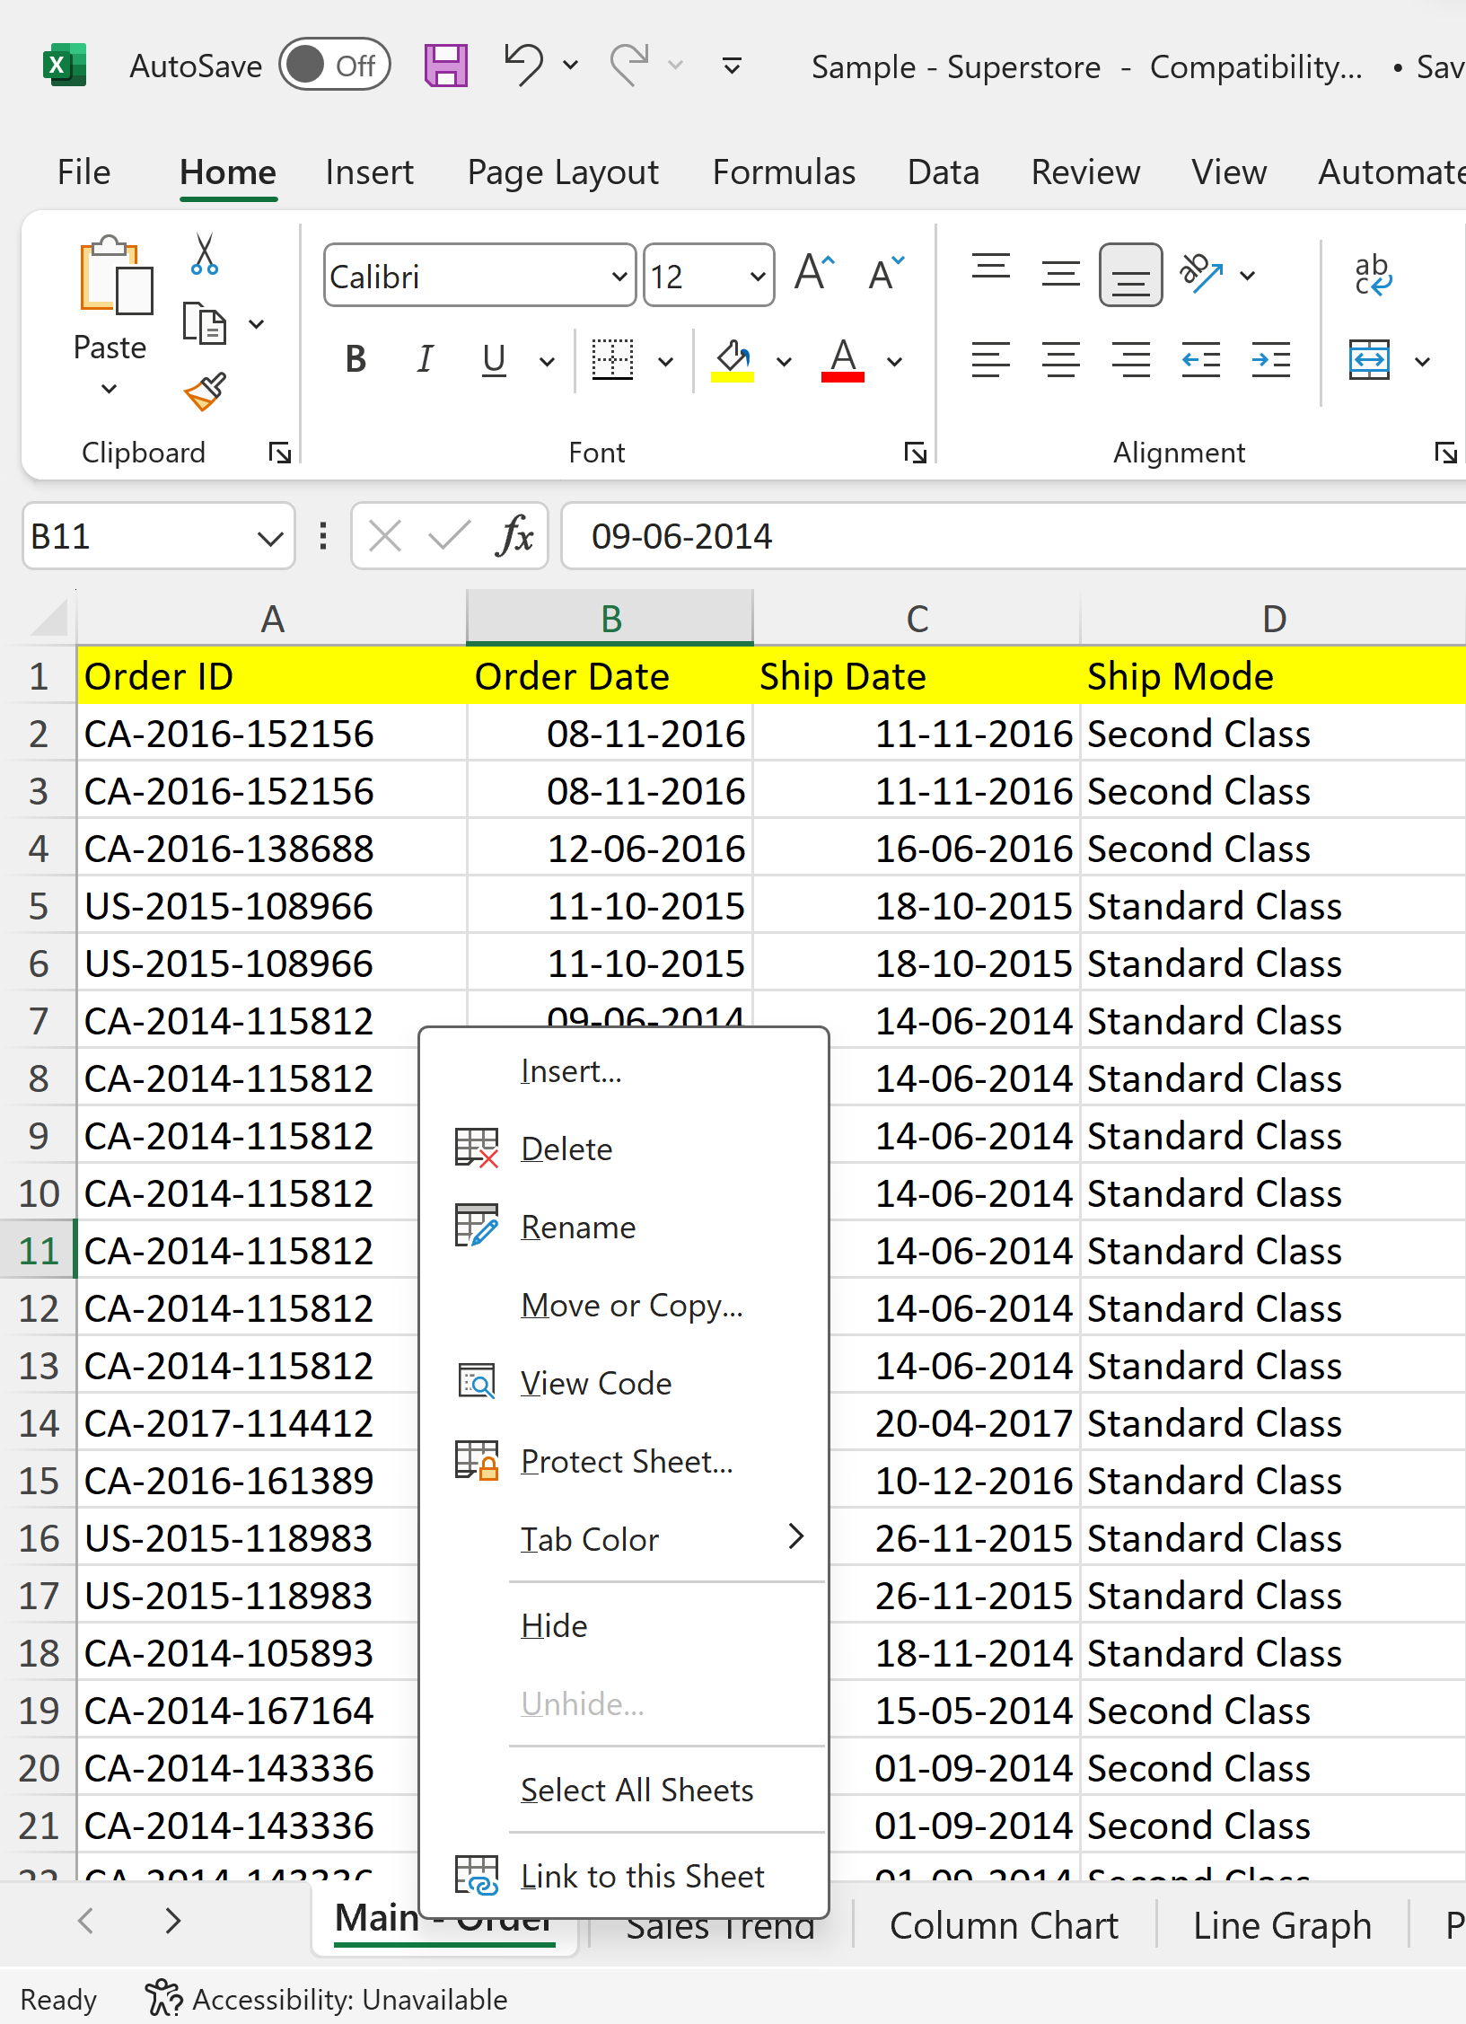
Cont...
Protecting Sheets
Sheet Protection: Prevent unauthorized changes by setting passwords and access rights.
Protect Workbook: Safeguard the entire workbook to control sheet additions or deletions.
Right Click on Sheet Name

Slide 28

Linking & Referencing Data Between Worksheets

Slide 29
Linking & Referencing Data Between Worksheets
Referencing Data between Sheets
Use cell references to link data between sheets.
Example: To reference cell A1 in Sheet2, enter = Sheet2!A1 in Sheet1.
Changes in Sheet2 reflect in Sheet1 dynamically
Check Sheet:-

Slide 30
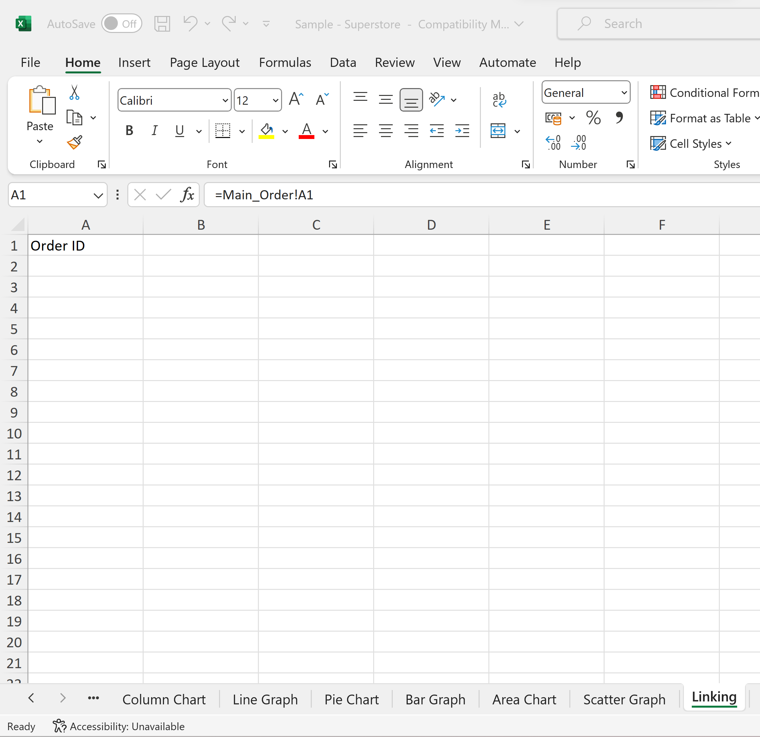
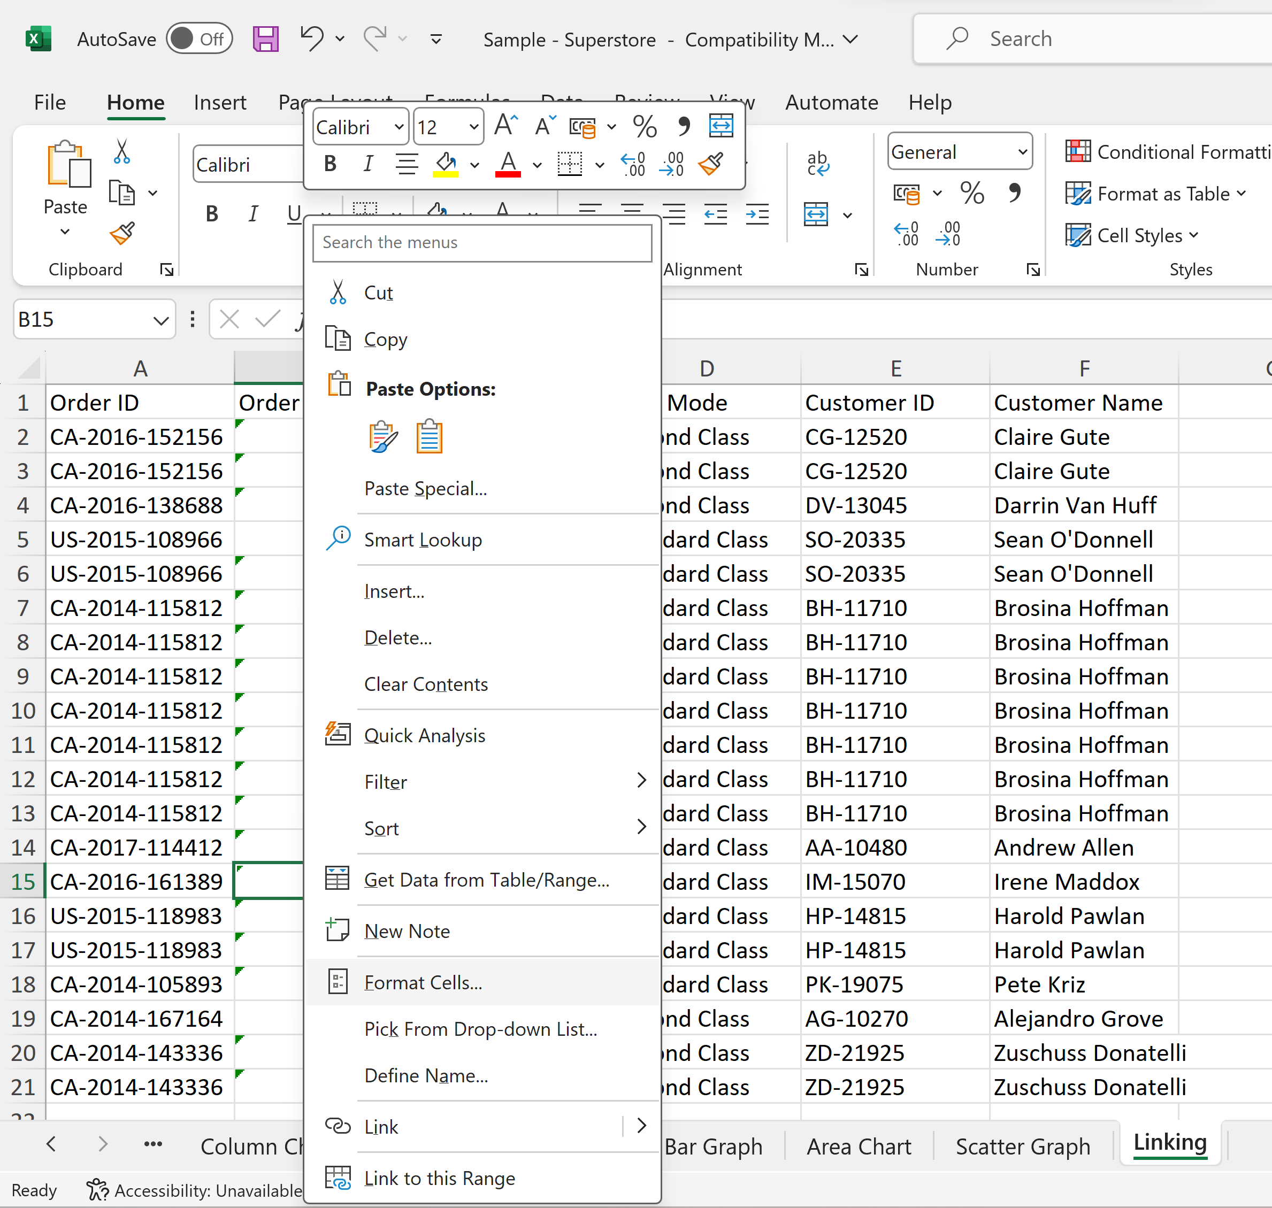
Cont...
Linking Data from Different Sheet
Drag & Drop, & then Change Date format

Slide 31
Handson Exercise

Slide 32
Thank You

